Slide 1


ADMIS Lab
先进数据与机器智能系统实验室
Recovery System
Chapter 19
Yichao Zhang
Email: yichaozhang@tongji.edu.cn
Department of Computer Science and Technology
Tongji University

Slide 2
Outline
Failure Classification
Storage
Recovery and Atomicity
Recovery Algorithms
Buffer Management

Slide 3
Failure Classification
Transaction failure (事务故障）
  Logical errors, e.g., illegal inputs
  System errors, e.g., dead locks
System crash (系统崩溃)
  A power failure, or other hardware and software failure causes the system to crash
Disk failure (磁盘故障）
  A head crash or similar disk failure destroys all or part of disk storage

Slide 4
Recovery Algorithms
Techniques to ensure database consistency and transaction atomicity despite failures
Recovery algorithms have two parts
  Actions taken during normal transaction processing
    保证有足够的信息用于故障恢复
  Actions taken after a failure
    恢复数据库到某个一致性状态

Slide 5
Outline
Failure Classification
Storage
Recovery and Atomicity
Recovery Algorithms
Buffer Management

Slide 6
Storage Structure
Volatile storage (易失性存储器)
  does not survive system crashes
  e.g., main memory, cache memory
Non-volatile storage (非易失性存储器）
  survives system crashes
  e.g., disk, tape, flash memory
Stable storage (稳定存储器)
  a mythical form of storage that survives all failures
  achieved by maintaining multiple copies on distinct non-volatile media

Slide 7
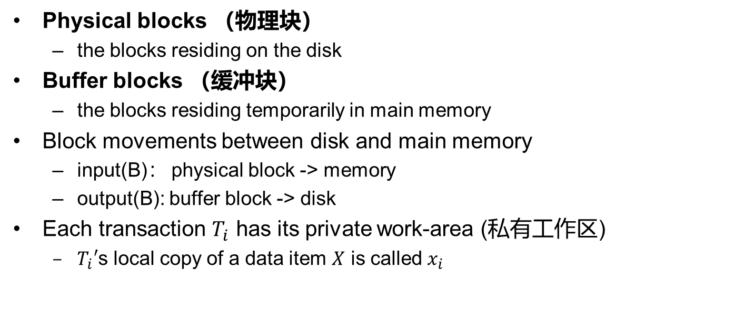
Data Access
Physical blocks （物理块）
  the blocks residing on the disk
Buffer blocks （缓冲块）
  the blocks residing temporarily in main memory
Block movements between disk and main memory
  input(B)： physical block -> memory
  output(B): buffer block -> disk
Each transaction $T_{i}$ has its private work-area (私有工作区)
  $T_{i}′$s local copy of a data item $X$ is called $x_{i}$

Slide 8
Data Access (Cont.)
Transaction transfers data items between system buffer blocks and its private work-area using
  read(X)
  write(X)
Transactions
  Perform read(X) while accessing X for the first time
  All subsequent accesses are to the local copy
  After the last access, transaction executes write(X)
output(B_{X}) does not need to immediately follow write(X)
  System can perform the output operation when it deems fit

Slide 9
Example of Data Access
buffer
Buffer Block A
x
input(A)
Buffer Block B
Y
A
output(B)
B
read(X)
write(Y)
disk
x₂
x₁
y₁
work area
of T₁
work area
of T₂
memory

Slide 10
Outline
Failure Classification
Storage
Recovery and Atomicity
Recovery Algorithms
Buffer Management

Slide 11
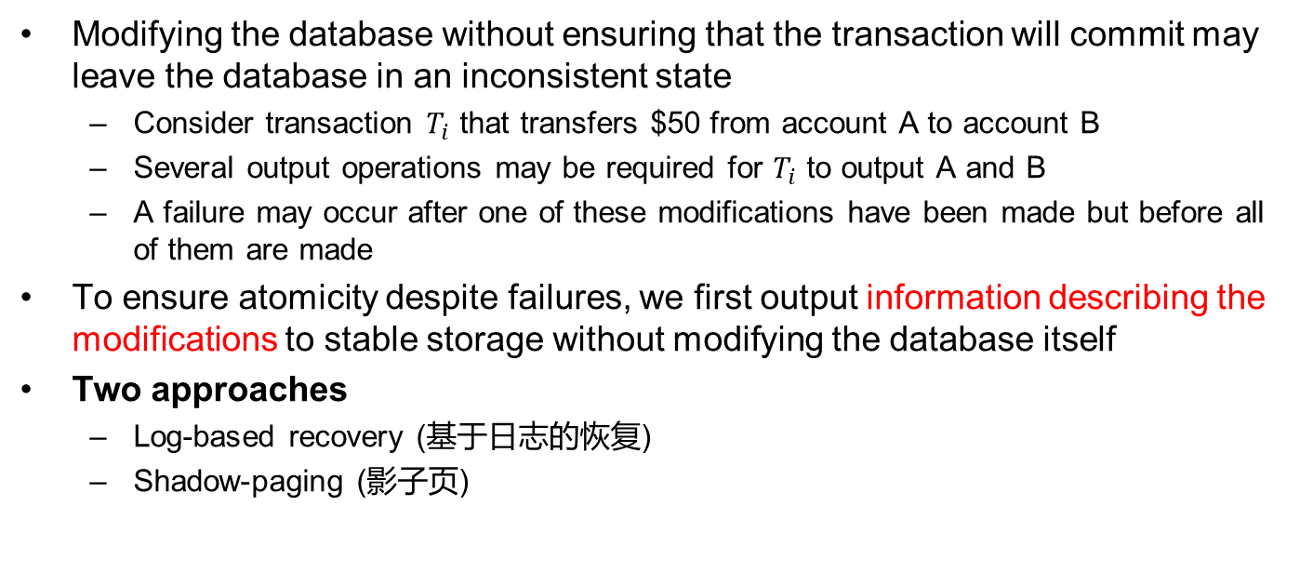
Recovery and Atomicity
Modifying the database without ensuring that the transaction will commit may leave the database in an inconsistent state
  Consider transaction $T_{i}$ that transfers $50 from account A to account B
  Several output operations may be required for $T_{i}$ to output A and B
  A failure may occur after one of these modifications have been made but before all of them are made
To ensure atomicity despite failures, we first output information describing the modifications to stable storage without modifying the database itself
Two approaches
  Log-based recovery (基于日志的恢复)
  Shadow-paging (影子页)

Slide 12
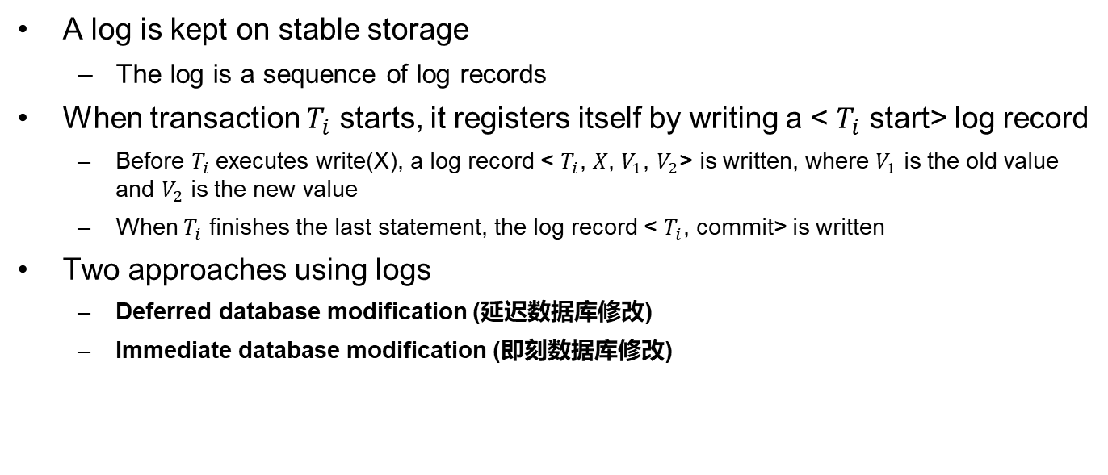
Log-based Recovery
A log is kept on stable storage
  The log is a sequence of log records
When transaction $T_{i}$ starts, it registers itself by writing a < $T_{i}$ start> log record
  Before $T_{i}$executes write(X), a log record < $T_{i}$, $X$, $V_{1}$, $V_{2}$> is written, where $V_{1}$ is the old value and $V_{2}$ is the new value
  When $T_{i}$ finishes the last statement, the log record < $T_{i}$, commit> is written
Two approaches using logs
  Deferred database modification (延迟数据库修改)
  Immediate database modification (即刻数据库修改)

Slide 13
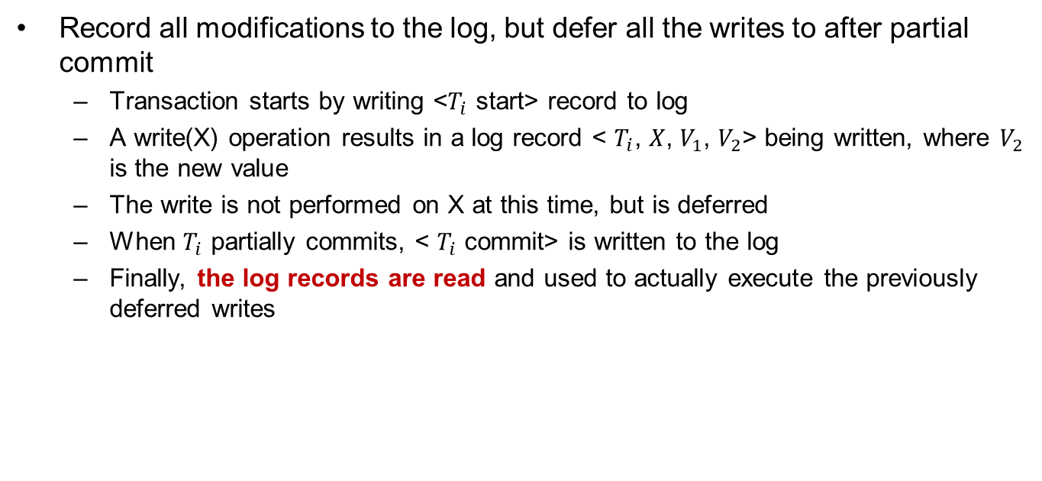
Deferred Database Modification
Record all modifications to the log, but defer all the writes to after partial commit
  Transaction starts by writing <$T_{i}$ start> record to log
  A write(X) operation results in a log record < $T_{i}$, $X$, $V_{1}$, $V_{2}$> being written, where $V_{2}$ is the new value
  The write is not performed on X at this time, but is deferred
  When $T_{i}$ partially commits, < $T_{i}$ commit> is written to the log
  Finally, the log records are read and used to actually execute the previously deferred writes

Slide 14
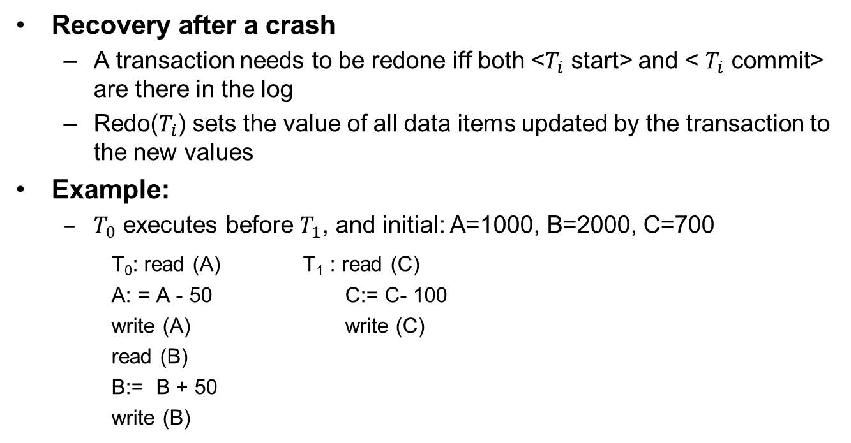
Deferred Database Modification (Cont.)
Recovery after a crash
  A transaction needs to be redone iff both <$T_{i}$ start> and < $T_{i}$ commit> are there in the log
  Redo($T_{i}$) sets the value of all data items updated by the transaction to the new values
Example:
  $T_{0}$ executes before $T_{1}$, and initial: A=1000, B=2000, C=700
T₀: read (A) T₁ : read (C)
A: = A - 50 C:= C- 100
write (A) write (C)
read (B)
B:= B + 50
write (B)

Slide 15
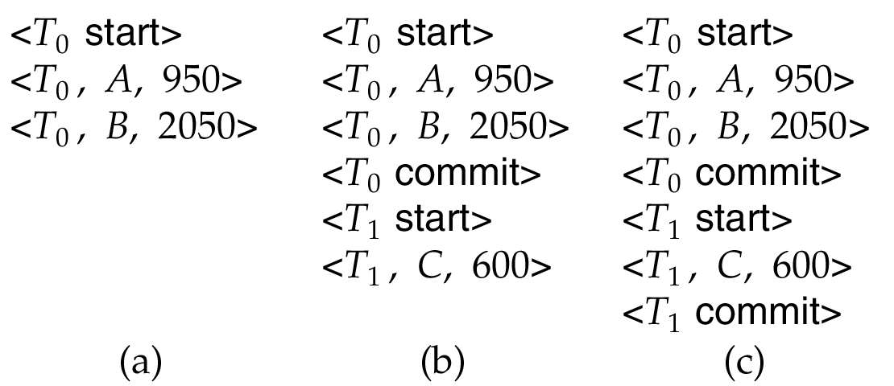
Deferred Database Modification (Cont.)
Recovery actions in each case above:
  (a) No redo actions need to be taken
  (b) redo(T₀) must be performed
  (c) redo(T₀) must be performed followed by redo(T₁)

Slide 16
Immediate Database Modification
Allows database updates of an uncommitted transaction
  Update log records must be written before database items are written
  The output of updated blocks can take place at any time before or after transaction commit
  Order in which blocks are output can be different from the order in which they are written

Slide 17
Immediate Database Modification Example
Log Write Output
<T₀ start>
<T₀, A, 1000, 950>
<T₀, B, 2000, 2050>
A = 950
B = 2050
<T₀ commit>
<T₁ start>
<T₁, C, 700, 600>
C = 600
<T₁ commit>
B_{B}, B_{C}
B_{A}
Note: B_{X} denotes the block containing X

Slide 18
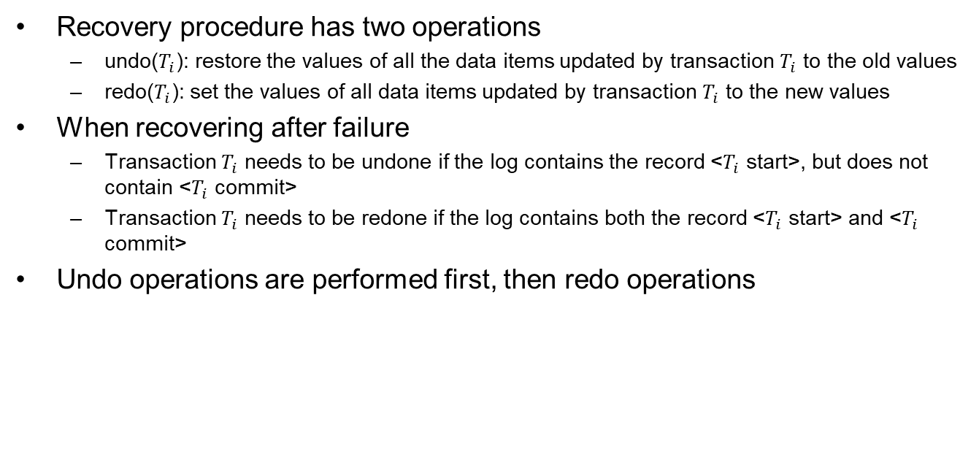
Immediate Database Modification (Cont.)
Recovery procedure has two operations
  undo($T_{i}$): restore the values of all the data items updated by transaction $T_{i}$ to the old values
  redo($T_{i}$): set the values of all data items updated by transaction $T_{i}$ to the new values
When recovering after failure
  Transaction $T_{i}$ needs to be undone if the log contains the record <$T_{i}$ start>, but does not contain <$T_{i}$ commit>
  Transaction $T_{i}$ needs to be redone if the log contains both the record <$T_{i}$ start> and <$T_{i}$ commit>
Undo operations are performed first, then redo operations

Slide 19
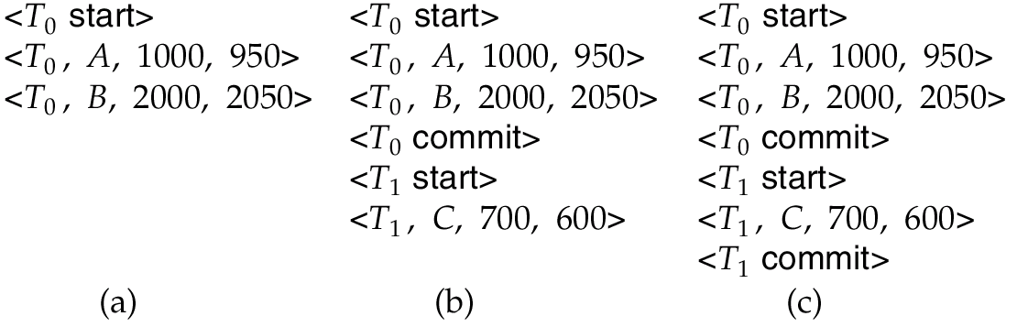
Immediate DB Modification Recovery Example
Recovery actions in each case above are:
  (a) undo(T₀)
  (b) undo(T₁) and redo(T₀)
  (c) redo(T₀) and redo(T₁)

Slide 20
Checkpoint (检查点)
Problems in the recovery procedure
  Searching the entire log is time-consuming
  Might unnecessarily redo transactions which have already output their updates to the database
Recovery procedure sets checkpoints periodically
  Output all the log records currently residing in main memory to stable storage
  Output all the modified buffer blocks to the disk
  Write a log record <checkpoint> to stable storage

Slide 21
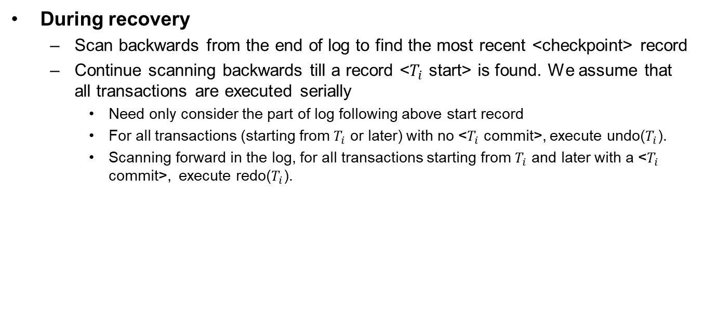
Checkpoints (Cont.)
During recovery
  Scan backwards from the end of log to find the most recent <checkpoint> record
  Continue scanning backwards till a record <$T_{i}$ start> is found. We assume that all transactions are executed serially
    Need only consider the part of log following above start record
    For all transactions (starting from $T_{i}$ or later) with no <$T_{i}$ commit>, execute undo($T_{i}$).
    Scanning forward in the log, for all transactions starting from $T_{i}$ and later with a <$T_{i}$ commit>, execute redo($T_{i}$).

Slide 22
Example of Checkpoints
T_{c}
T_{f}
T₁
T₂
T₃
T₄
checkpoint
system failure
T₁ can be ignored (updates have been already output to disk according to the checkpoint)
redo T₂ and T₃
undo T₄

Slide 23
Outline
Failure Classification
Storage
Recovery and Atomicity
Recovery Algorithms
Buffer Management

Slide 24
Recovery with Concurrent Transactions
Modify the log-based recovery scheme to allow multiple transactions to execute concurrently
  All transactions share a single disk buffer and a single log
  A buffer block can have data items updated by one or more transactions
Assume that concurrency control uses strict two-phase locking
Logging is done as described earlier
  Log records of different transactions may be interspersed（散布）in the log
The checkpointing technique and actions taken on recovery have to be changed

Slide 25
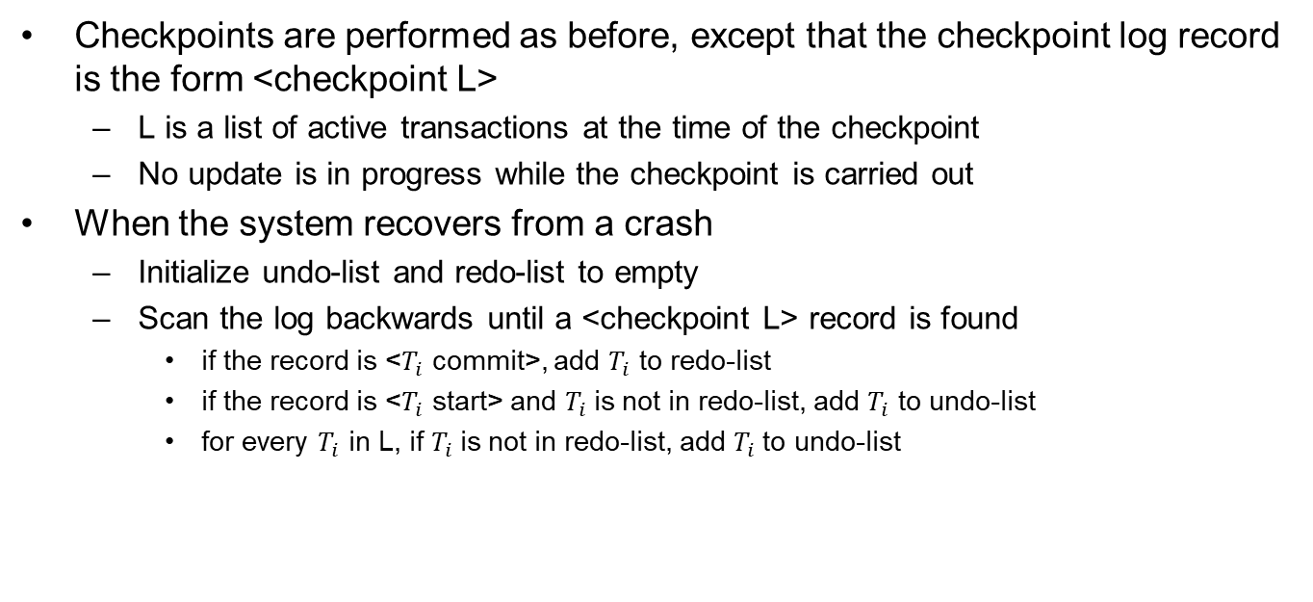
Recovery with Concurrent Transactions (Cont.)
Checkpoints are performed as before, except that the checkpoint log record is the form <checkpoint L>
  L is a list of active transactions at the time of the checkpoint
  No update is in progress while the checkpoint is carried out
When the system recovers from a crash
  Initialize undo-list and redo-list to empty
  Scan the log backwards until a <checkpoint L> record is found
    if the record is <$T_{i}$ commit>, add $T_{i}$ to redo-list
    if the record is <$T_{i}$ start> and $T_{i}$is not in redo-list, add $T_{i}$ to undo-list
    for every $T_{i}$ in L, if $T_{i}$is not in redo-list, add $T_{i}$to undo-list

Slide 26
Example of Recovery
Go through the steps of the recovery algorithm on the following log
        <T₀ start>
        <T₀, A, 0, 10>
        <T₀ commit>
        <T₁ start>
        <T₁, B, 0, 10>
        <T₂ start>
        <T₂, C, 0, 10>
        <T₂, C, 10, 20>
        <checkpoint {T₁, T₂}>
        <T₃ start>
        <T₃, A, 10, 20>
        <T₃, D, 0, 10>
        <T₃ commit>

Slide 27
Recovery with Concurrent Transactions (Cont.)
Recovery
  Scan log backwards from the end of the log
    During the scan, perform undo for each log record that belongs to a transaction in undo-list
  Locate the most recent <checkpoint L> record
  Scan log forwards from the <checkpoint L> record till the end of the log
    During the scan, perform redo for each log record that belongs to a transaction on redo-list

Slide 28
Outline
Failure Classification
Storage
Recovery and Atomicity
Recovery Algorithms
Buffer Management

Slide 29
Log Record Buffering
Log record buffering
  Log records are buffered in main memory, instead of being output directly to stable storage
  Log records are output to stable storage when a block of log records in the buffer is full, or a log force operation is executed
  Log force is performed to commit a transaction by forcing all its log records (including the commit record) to stable storage
  Several log records can be output using a single output operation, thus reducing the I/O cost

Slide 30

Log Record Buffering (Cont.)
Write-ahead logging (WAL) rule for buffering log records
  Log records are output to stable storage in the order in which they are created
  Transaction $T_{i}$ enters the commit state only when the log record <$T_{i}$ commit> has been output to stable storage
  Before a block of data in main memory is output to the database, all log records pertaining to data in that block must have been output to stable storage
Notes:
pertaining to ：与…有关

Slide 31
Database Buffering
Database maintains an in-memory buffer of data blocks
  When a new block is needed, an existing block should be removed from buffer if the buffer is full
  If the block chosen for removal has been updated, it must be output to disk
No update should be in progress on a block when it is output to disk, which is ensured as follows
  Before writing a data item, transaction acquires exclusive lock on block containing the data item
  Lock can be released once the write is completed.
    Such locks held for short duration are called latches 闩锁
  Before a block is output to disk, the system acquires an exclusive latch on the block
    Ensures no update can be in progress on the block
Notes:
闩：shuān

Slide 32
Buffer Management (Cont.)
Database buffer can be implemented either
  In an area of real main-memory reserved for the database, or in virtual memory
Implementing buffer in reserved main-memory has drawbacks
  Memory is partitioned before-hand between database buffer and applications, limiting the flexibility of main-memory
  Needs may change, and although operating system knows best how memory should be divided up at any time, it cannot change the partitioning of memory

Slide 33
Buffer Management (Cont.)
Database buffers are generally implemented in virtual memory in spite of some drawbacks
  When OS needs to evict（逐出）a page that has been modified, the page is written to swap space on disk
  When DB decides to write buffer page to disk, buffer page may be in swap space (交换区), and may have to be read from swap space on disk and output to the database on disk, resulting in extra I/Os
    Known as dual paging（双分页）problem
  Ideally when swapping out a database buffer page, operating system should pass control to database, which in turn outputs the page to database instead of to swap space
    Dual paging can thus be avoided, but common operating systems do not support such functionality

Slide 34
Failure with Loss of Nonvolatile Storage
Technique similar to checkpointing used to deal with loss of non-volatile storage
  Periodically dump the entire content of the database to stable storage
  No transaction may be active during the dump procedure; a procedure similar to checkpointing must take place
    Output all log records currently residing in main memory onto stable storage
    Output all buffer blocks onto the disk
    Copy the contents of the database to stable storage
    Output a record <dump> to log on stable storage
  To recover from disk failure
    Restore database from the most recent dump
    Consult the log and redo all transactions that committed after the dump
Can be extended to allow transactions to be active during dump, known as fuzzy dump or online dump

Slide 35
End of Chapter 19

